Slide 1
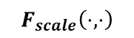
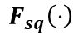
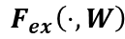
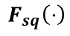
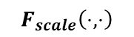
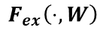
$$F_{ex}\left(⋅, W\right)$$
$$F_{ex}\left(⋅, W\right)$$
$$F_{scale}\left(⋅,⋅\right)$$
$$F_{sq}\left(⋅\right)$$
$$F_{scale}\left(⋅,⋅\right)$$
$$F_{sq}\left(⋅\right)$$
Squeeze-and-Excitation Module
Squeeze-and-Excitation Module
Real/Fake
SE-Unet-Generator
SE-Discriminator

Slide 2


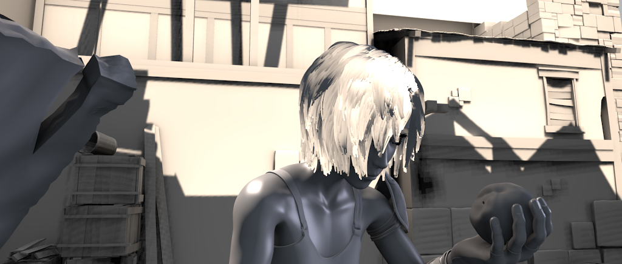
albedo
input
shading

Slide 3
Unet

Slide 4
Se-module
Se-module
Se-module
Se-module
SE-Unet

Slide 5
Se-module
Channel scale /8
Se-module
Channel scale /4
Se-module
Channel scale /2
Se-module
Channel scale /1
SES-Unet

Slide 6
Resnet Block
albedo
input
conv
Resnet Block
OctConv Block
OctConv Block
Resnet Block
shading

Slide 7
Sigmiod-Conv
Sigmiod-Conv
Sigmiod-Conv
Sigmiod-Conv
Logit

Slide 8
输入图像
跳跃分频的生成器
多尺度预测的鉴别器
定义损失函数
网络优化

Slide 9
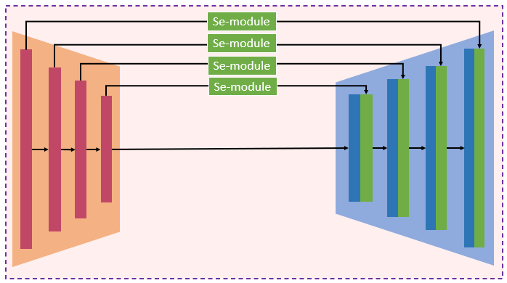
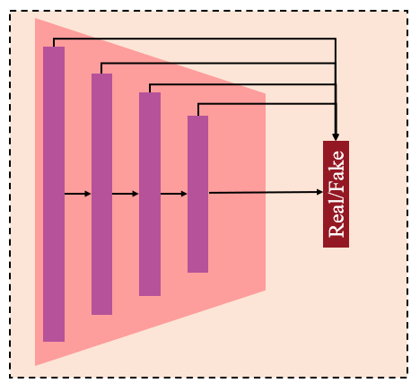
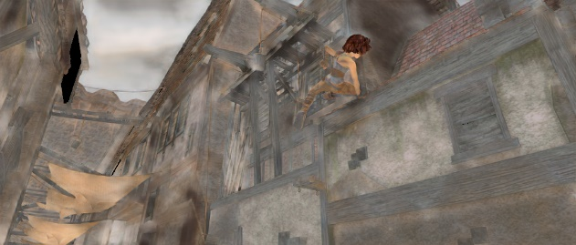
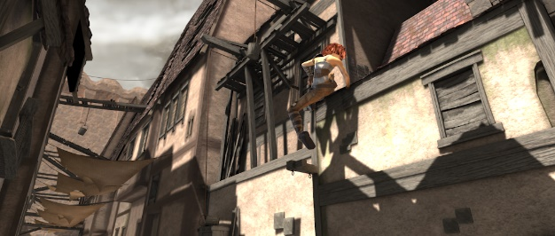
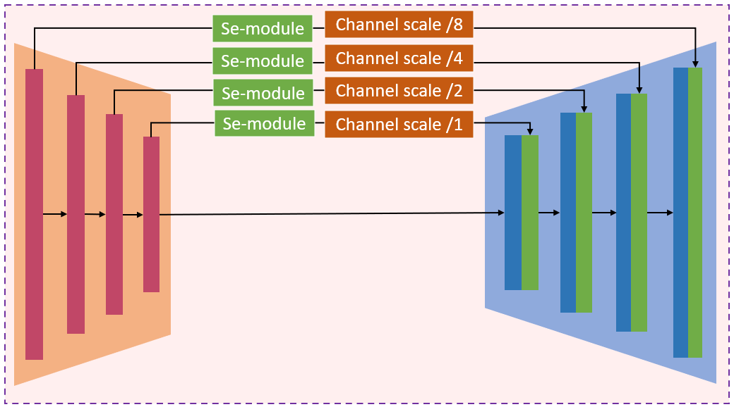


Slide 10
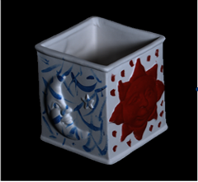
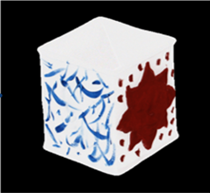
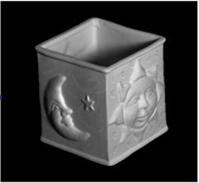


(a)
(b)
(c)

Slide 11
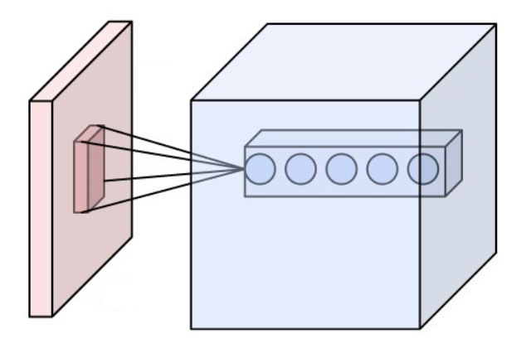
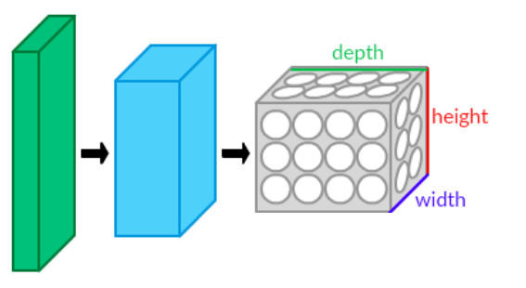
(a)
(b)

Slide 12
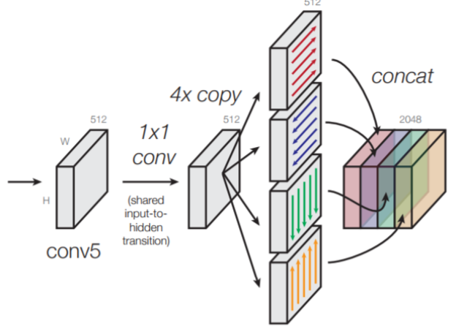
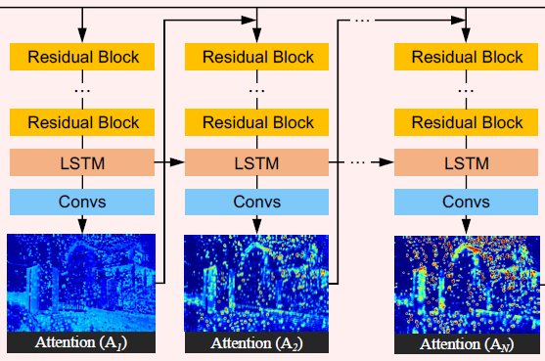
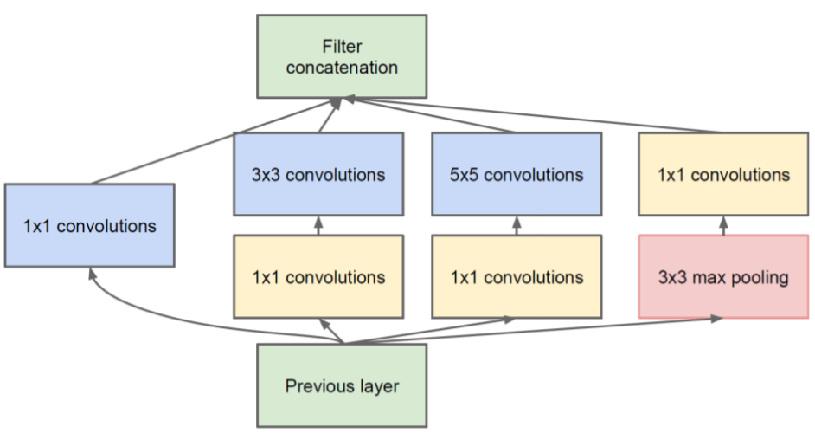

Slide 13


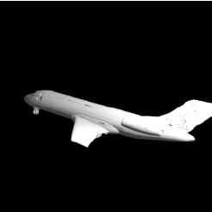
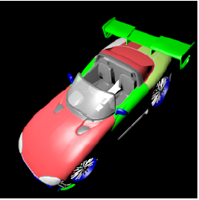

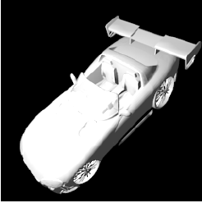
input
Albedo
Shading

Slide 14
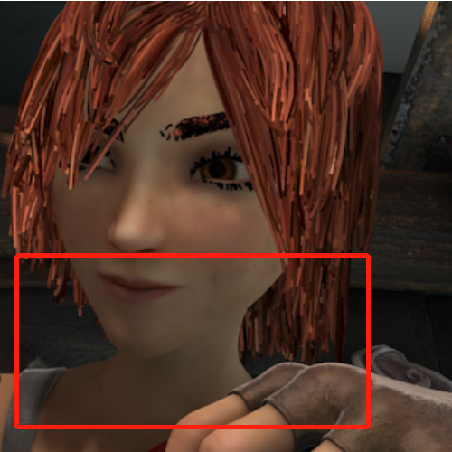
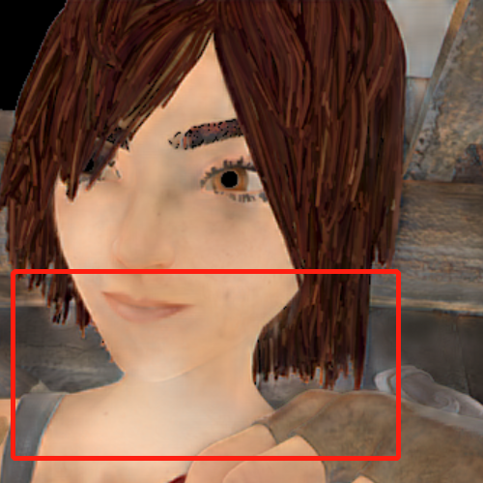
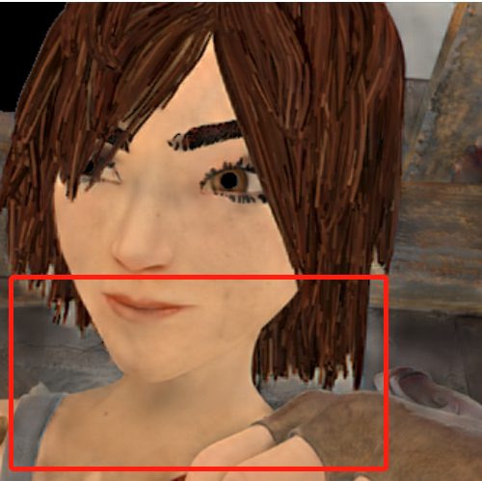
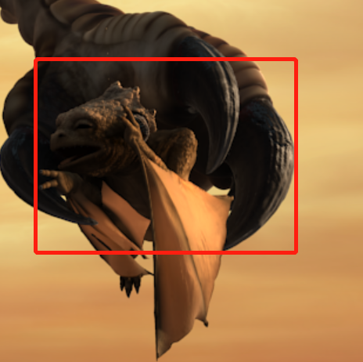
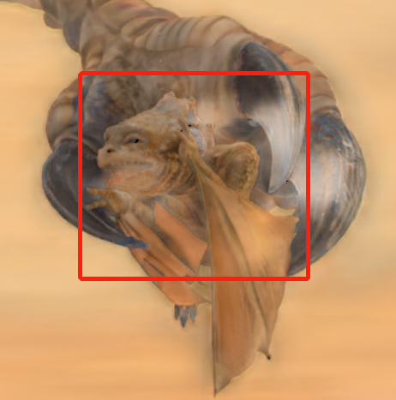
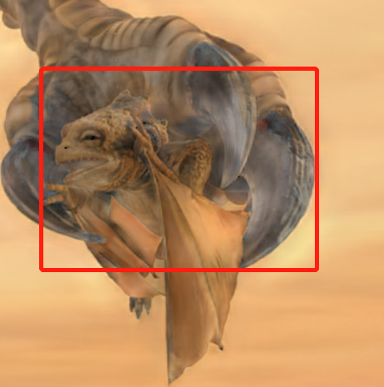
input
Without Skip SE
With Skip SE

Slide 15






rb
$$E_{t}$$
$$D_{t}$$
up
cat
rb
cat
$$E_{m}$$
$$D_{m}$$
up
cat
rb
cat
$$E_{b}$$
$$D_{b}$$
input
output

Slide 16
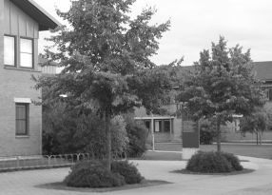




Slide 17
图像金字塔
原始图像
P-Net
检测框
R-Net
检测框
O-Net
结果

Slide 18
Input
Down Block
Inception Block
output
Input
Conv Block
UpSample
ResNet Block
output
(a) Top、Middle层级下的解码器结构
Input
Inception Block
UpSample
ResNet Block
Last-layer
output
(b) Bottom层级下的解码器结构

